Slide 1
AIR TO GROUND RECON SYSTEM
Group 20
Hamza Nawaz – EE
Jerrod Rout – EE
Nate Jackson – EE
William Isidort – EE

Slide 2


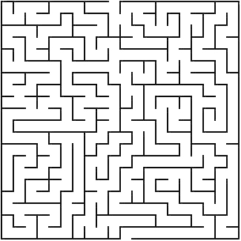
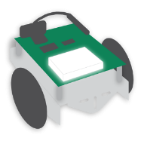
Maze Solver Overview
Video Transmission
Entrance
Exit
Vehicle Commands

Slide 3
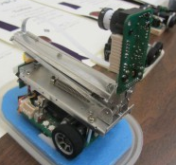
Motivation
Technological boom in Autonomous Vehicles and UAVs
Search & Rescue/Search & Destroy Missions
Good project for developing our programming capabilities
Extension of Robotics Systems project
Micromouse Competition
MM-7A by Shinichi Yamashita (pictured right)

Slide 4
Goals & Objectives
Lightweight – Both the UAV and the ground vehicle must be light enough to be easily transported on foot.
Operating Duration – Limited by battery life and weight of each vehicle since both must be functioning in order to solve the maze.
Wall Detection – Walls of the maze must be detectable by both the ground vehicle and computer vision techniques.
Object Detection – A “goal” object placed in the maze will be located by the ground vehicle based on color thresholding.
Maze Solving – Algorithms will be used to solve the maze image and navigational cues will be sent to the ground vehicle.

Slide 5
Requirements & Specifications
Component | Parameter | Specification
Camera | Resolution | 640 x 480 pixels
Wireless Video Transmitter | Range | Min. 50 ft.
RF Transceivers (XBee modules) | Range, Data Transfer Rate | Min. 50 ft., 100kbps
Quadcopter | Weight, Battery Life | Max 5 lbs., 30min
Ground Vehicle | Weight, Battery Life, Speed | 5 lbs., 30 min, 1ft/sec
As our contributions, we had to buy the following components:
As our contributions, we had to buy the following components:

Slide 6
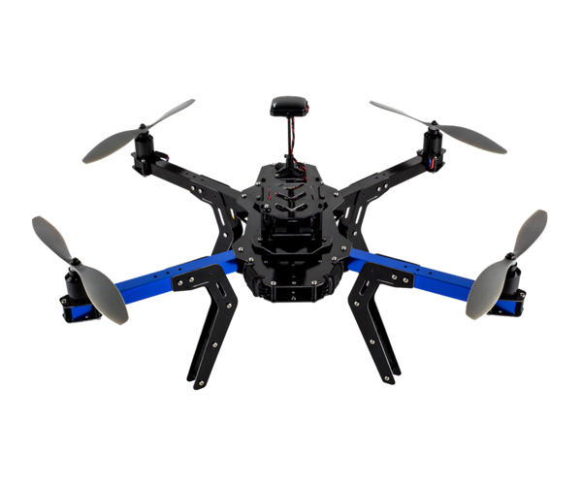
Quadcopter
3DR DIY Quadcopter frame was provided by Dr. Richie.
It was incomplete quad that we had to diagnose and repair before make sure
As our contributions, we had to buy the following components:
RC Transmitter/Receiver( to control manually)
Landing legs
Rechargeable LiPo battery
Telemetry set
Propellers
Mission planner software is installed for controlling the quad wirelessly via the telemetry set.

Slide 7
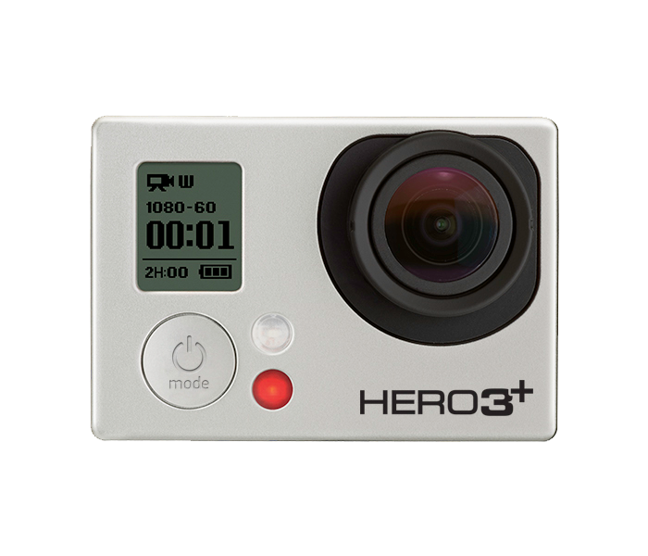
Camera Specifications
GoPro Hero 3+
Company | GoPro
Battery Life | 2 hours
Price | $100
Weight | 135g
Resolution | 1080p, 60 FPS

Slide 8
Video Transmission
Live feed from the quadcopter will be used as an input to our maze solving program.
Will be transmitting at a 5.8 GHz Frequency, at no more than a range of 100 ft.
The receiving signal will be fed through an analog to digital video converter in order for OpenCV to use the live stream from the camera as an input.
Camera
Video Transmitter
Video Receiver
A/D Video Converter
USB Input to PC

Slide 9
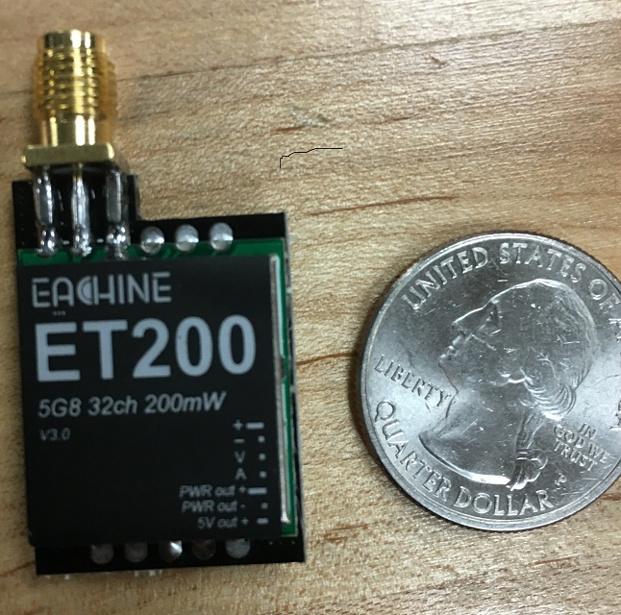
Video Transmitter
Company | Eachine
Operating Voltage | 7-24V
Channels | 32
Price | $40
Weight | 15g (with antenna)
Frequency | 5.8GHz
Power Output | 200mW

Slide 10
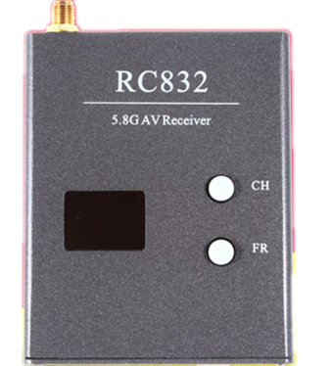
Video Receiver
RC832 Receiver
Company | Eachine
Operating Voltage | 12V
Channels | 32
Price | $36.99
Weight | 85g (with antenna)
Frequency | 5.8GHz
Working Current | 200mA

Slide 11
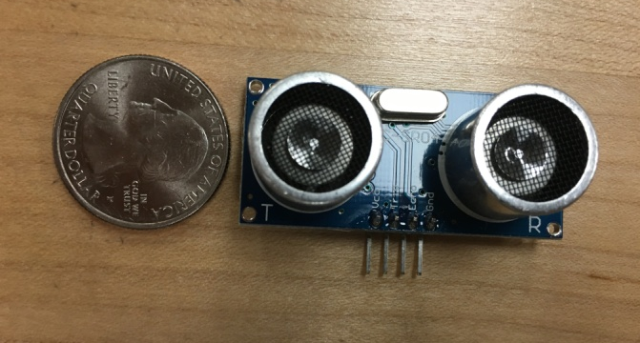
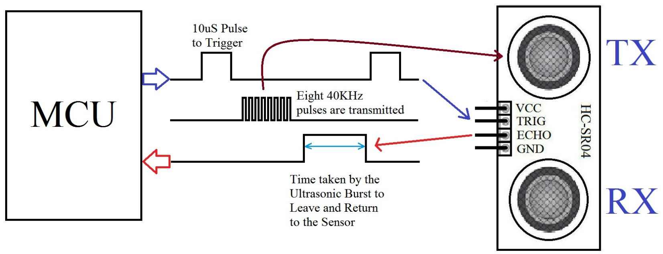
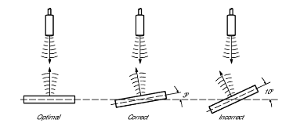
Ultrasonic Sensors
Cost (5pcs.) | $8.69
Operating Voltage | 5V
Supply Current | 15mA
Power Consumption | 75mW
Range | 2-500cm
Weight | 15g
Three proximity sensors (front, left, right) will be used to prevent the ground vehicle from crashing into the walls of the maze.
Unlike Infrared sensors, their measurements are not affected by optical reflectivity and color of the target.

Slide 12
Maze
The maze is one part of our project. It has to be modifiable. There should be at least to one path that can lead to the target.
All pathways’ dimensions have same size based on the ground vehicle specific dimension. For instance, we chose 1.5ft for the path because our robot is 9 inches long.
The maze is completely black and white. We chose it to be that color because the software using to generate the solution is doing binary thresholding.
¾ in X 8ft X 4ft PolyIsocyanurate Insulated Sheathing is used for the walls.
Blue poster board was chosen for the border because it is really hard for the software to detect the maze’s border using just the walls’ thickness.
All turning angles left are 90 degrees.

Slide 13
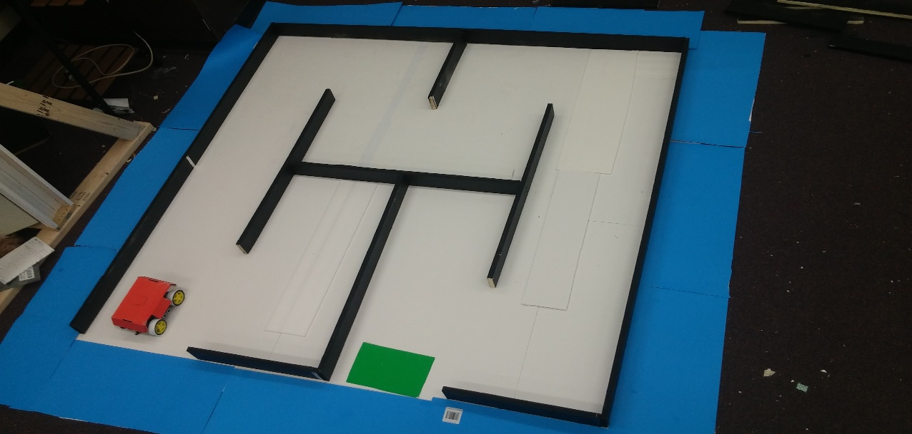
Maze design
The maze dimensions are as follow:
6 x 6 square feet
1.5ft pathway
A starting point represent by the color and the green is our target
Tools needed are just a knife, and ruler.

Slide 14
Software

Slide 15
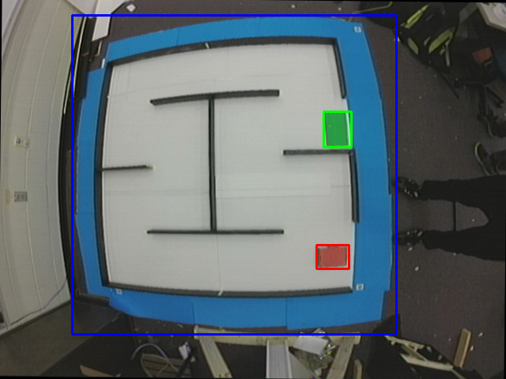
Detecting the Maze
GoPro Hero3+ video mode eliminates need to calibrate camera and remove lens distortion.
Color thresholding is used in combination with contouring to locate the boundaries of the maze (blue), the start location (red) , and the end location (green).
The coordinates of the start and end locations are found and stored for use in maze solving.

Slide 16
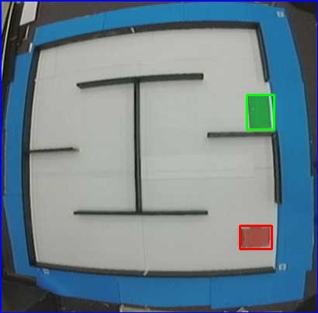
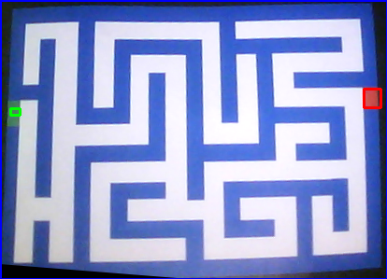
Extracting the Maze
Once these regions have been located, the maze will be cropped to remove background noise that could interfere with the solution.
This is performed by drawing a bounding box around the maze that minimizes the area enclosed.

Slide 17
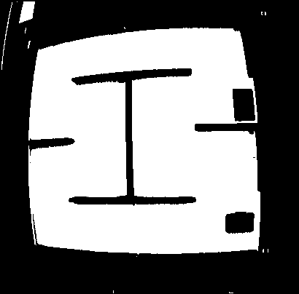

Binarization
Once the maze has been found and extracted, binary thresholding is performed to create a black and white image.
The degree of binary thresholding depends on environmental lighting.
This is done to enable the pixels representing the floor (white) and wall (black) to be differentiated.

Slide 18
Text Representation
The binary image is converted into a text file so that nodes that are part of the floor path can be connected and the solution of the maze can be visualized.
In this file, white pixels (floor) are represented as ‘0’ and black pixels (wall) are represented as ‘1’.
The start and end locations are represented by ‘S’ and ‘E’ characters, respectfully. These locations are padded with extra ‘0’s’ to ensure that the start and end nodes are always connected.

Slide 19
Minimum Path Width Threshold
Before the Hough transform is used to locate paths in the maze image, the average path width is computed. This is accomplished by counting the number of ‘0’s’ between two ‘1’ characters in the maze’s text representation.
The most frequent number of ‘0’s’ counted is assumed to represent the path width of the maze and this number is used to determine if a Hough line represents an actual wall in the maze.

Slide 20
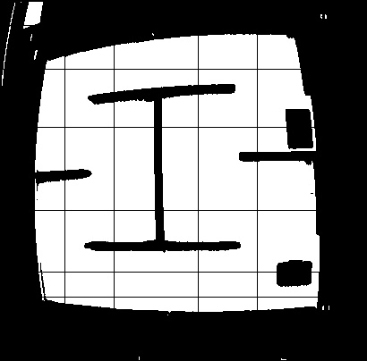
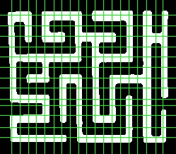
Finding Hough Lines
The Hough line transform is used to locate paths in the maze.
First, Hough lines detected in the image are differentiated as being horizontal or vertical based on the endpoints of each line. All slanted lines are removed.
The presence of a path is determined by the path width threshold. If the distance between two neighboring Hough lines is greater than this threshold, a new line representing the middle of the path will be drawn between them.

Slide 21
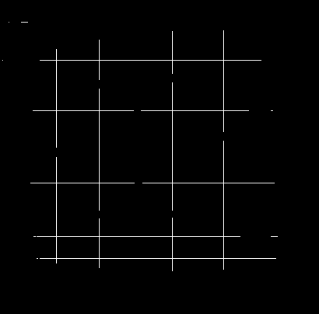
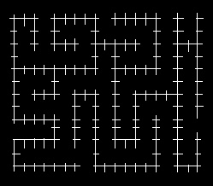
Creating a 1px Width Path
Once Hough lines are found in an image and drawn, the new image is subtracted from a solid black image of the same size.
The result is a 1px thick path representing the layout of the maze.

Slide 22
Connecting Nodes and Solving the Maze
The 1px thick path image is converted into a text file and each of the ‘0’, ‘S’, and ‘E’ characters (white, floor) are represented as a node and added to a graph. These nodes are connected to one another vertically and horizontally.
The root node, ‘S’, is added to a queue and a BFS (Breadth-First Search) algorithm is performed to solve the maze.
Backtracking is used find the path between the start and end nodes.

Slide 23
Translating the Solution and Sending Commands
A list of nodes in the solution path is traversed and cardinal directions are assigned according to their positions relative to one another.
These directions are then interpreted and forward (‘F’), right (‘R’), and left (‘L’) commands are created.
These commands are then filtered and added to a string according to the size of the maze and distance the robot travels per ‘F’ command.
The string of commands is then sent as a packet to the robot.

Slide 24
Wireless Communication

Slide 25
Wireless Technologies
Bluetooth | Wi-Fi | Zigbee
Easy to set up | Easy to set up | Easiest to set up
Low power consumption | Higher power consumption | Low power consumption
Low Range | Long Range | Long range
Sufficient Bandwidth | Sufficient Bandwidth | Sufficient Bandwidth

Slide 26
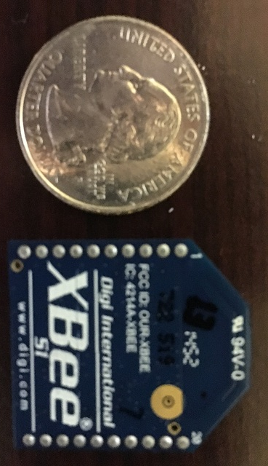
Wireless Communication
XBee (802.15.4) 1mW w/ Trace Antenna will be used for wireless RF communication between the computer and ground vehicle.
Operating Voltage / Transmit Current | 3.3V / 50mA
Price | $24.95
Data Transfer Rate | 250kbps
Range | 300ft (Outdoors)
Transmit Power output | 1mW
I/O | 6 Digital I/O, 6 ADC Input Pins
Frequency | 2.4 GHz

Slide 27
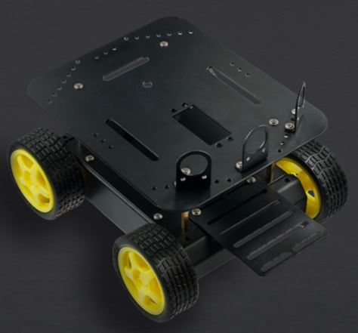
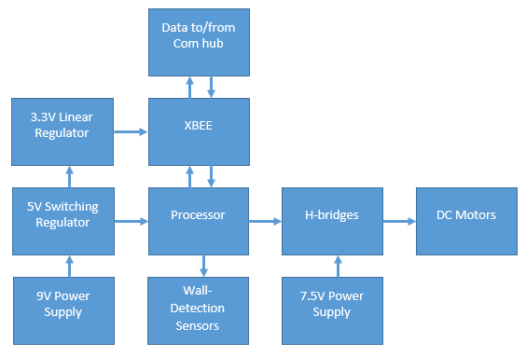
Ground Vehicle
Pirate 4WD Robot Platform
Dimensions | 200 x 170 x 105 mm
Power Supply Voltage | 7.5 V
Battery Life | 1.5 hours
Recharge Time | 10 hours
Weight | 45 g
Minimum Speed | 0.5 m/s
Maximum Speed | 1 m/s

Slide 28
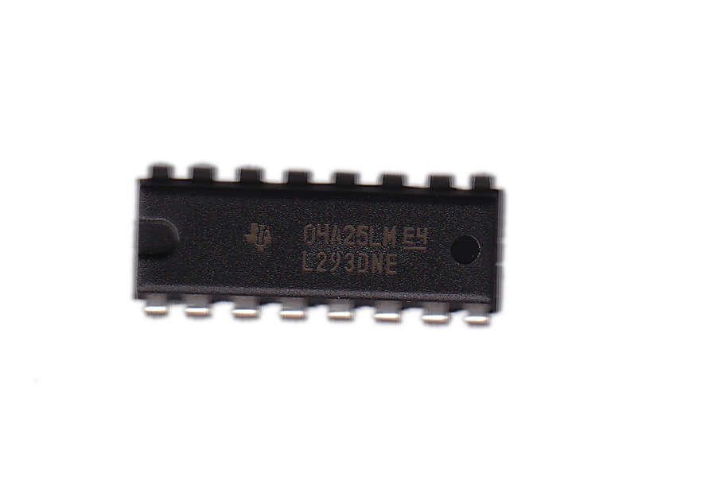
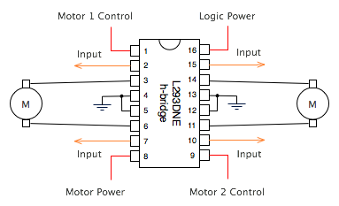
L293DNE H-Bridges
In order to control and drive the motors we are using dual sided L293DNE Motor Drivers
Each side of the robot is tied together, by doing so we were able to cut down on the number of digital I/O pins used by tying enable and control pins together.

Slide 29
Processor Selection
 | AM3359 Sitara | ATmega328 | MSP430G2553 | PIC16F690
Architecture | 32-Bit RISC | 8-Bit RISC | 16-Bit RISC | 8-Bit RISC
Frequency | 800 MHz | 20 MHz | 16 MHz | 20 MHz
I/O Supply Voltage | 1.8 V-3.3 V | 1.8 V-5.5 V | 1.8 V-3.6 V | 2 V-5.5 V
Code Storage | 64 KB OCMC RAM | 16 KB FLASH | 16 KB Non-volatile | 7 KB Flash
I/O Pins | 4 Banks x 32 GPIO Pins | 28 Pin PDIP | 80 GPIO Pins | 18 I/O Pins
Development Board | BeagleBone Black | Arduino Uno, DueMilanove, etc. | MSP430 Launchpad | Explorer 8 Development Kit, etc.

Slide 30
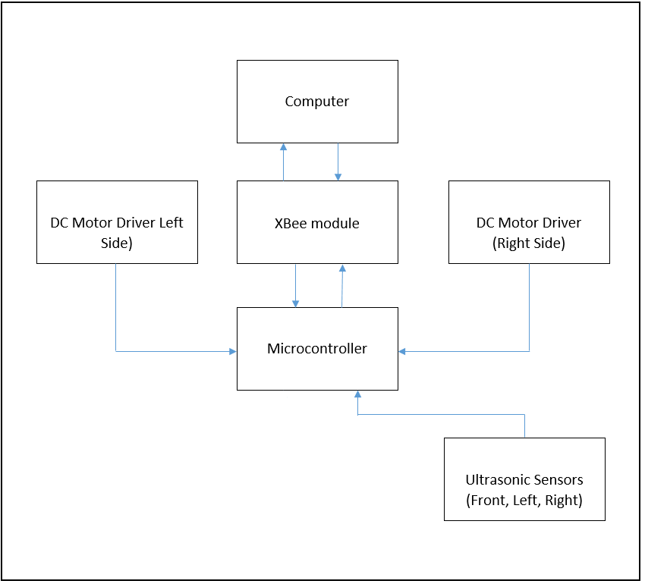
MCU Block Diagram

Slide 31
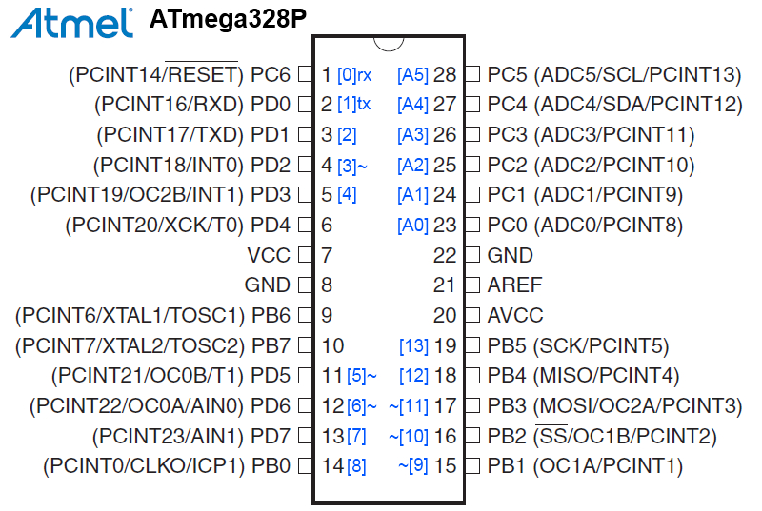
Microcontroller
32 KB of In-System Self-Programmable Flash Program Memory
1 kB EEPROM
2 KB Internal SRAM
Programmable Serial USART
Master/Slave SPI Serial Interface
I²C Compatible

Slide 32
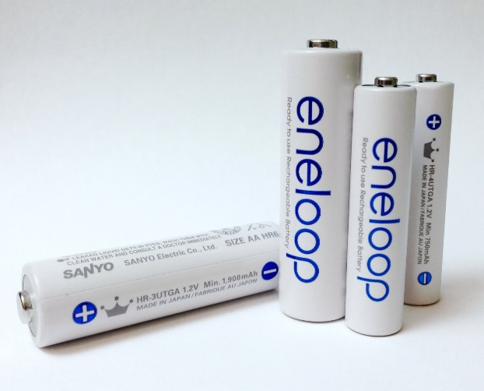

Power Supply
$Optimal Discharge Rate:$
$200mA+4∙170mA=880mA$
$C−rate:$
$\frac{2300mAh}{1A}=2.3 Hours$

Slide 33
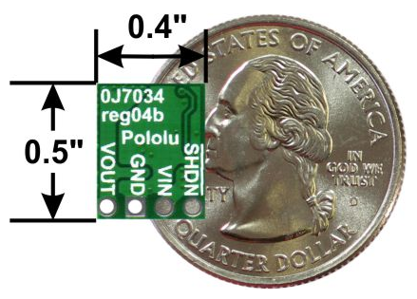
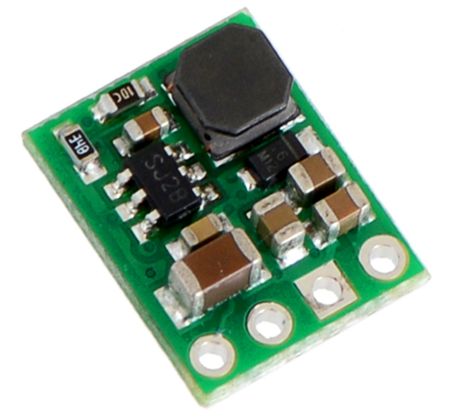
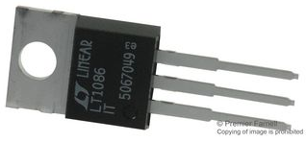
Power Supply Circuitry
Pololu 5V Switching Regulator Circuit
Linear Technology 3.3V Linear Regulator
Development board recommended minimum voltage of 7V and critical lower limit of 6V
Pololu D24V6F5 has ~1V dropout voltage
Linear Technology LT1086 – high efficiency, low dropout voltage

Slide 34
PCB Design
Designed in Eagle CAD 7.5.0
2-layer board
Copper pours on both sides for better grounding and heat sinking
All PTH components with DIP/SIP sockets added to speed up replacement
Fabricated by Osh Park; Used Osh Park DRU
0.016” dia. traces, 45 deg. angle routing

Slide 35
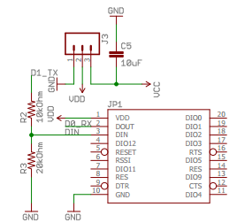
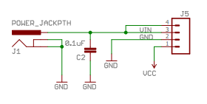
PCB Schematics – Power & Communications
Communications Circuitry
9V Power Supply Circuitry

Slide 36
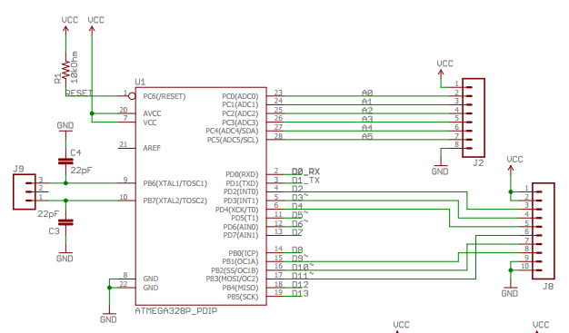
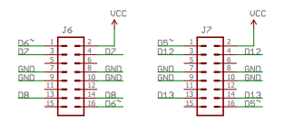
PCB Schematics – MCU & Motor Control
MCU Circuitry
H-Bridges

Slide 37
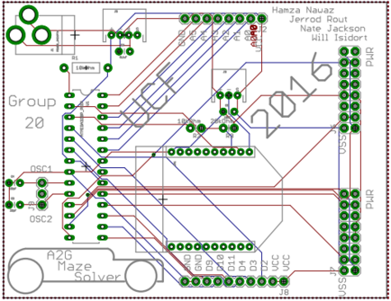
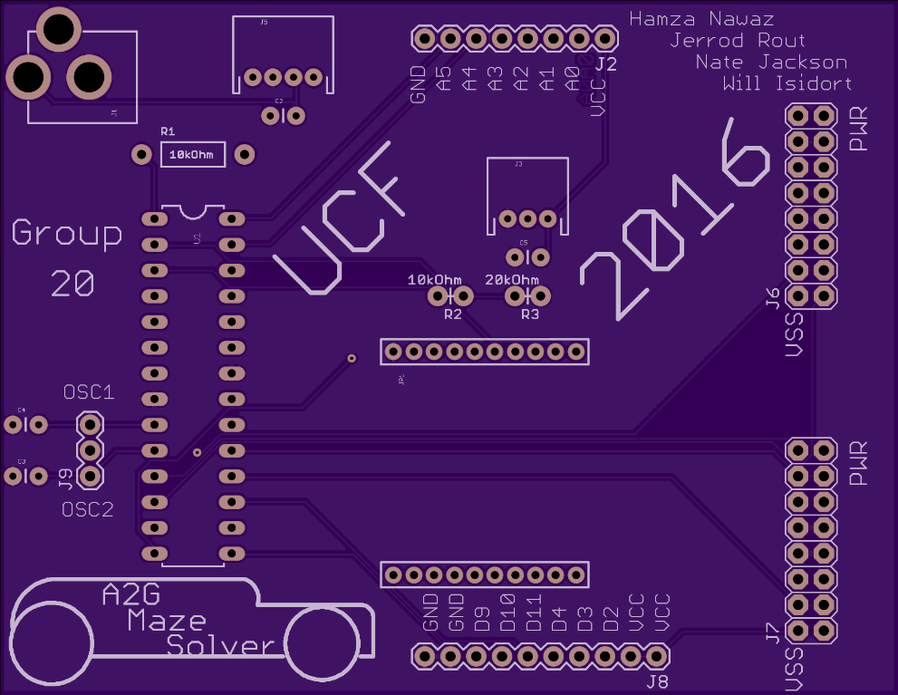
PCB Layout
Synthesized PCB Layout
Unpopulated PCB

Slide 38
Embedded System Program Flow
Processor accepts command string with 3 types of remote commands (forward, left, right) and inputs them into MCU serial buffer
Cycles through all the commands using a switch statement.
Forward commands stops if given too many using front ultrasonic sensor to avoid wall collision.
Ground Vehicle goes forward or turns based on remote sensing, if vehicle stops short before turn, the turn command senses the wall until it can perform the turn to avoid wall collision.
Side ultrasonic sensors allow for path correction to avoid wall collissions, depending on the distance the two sensors read.

Slide 39
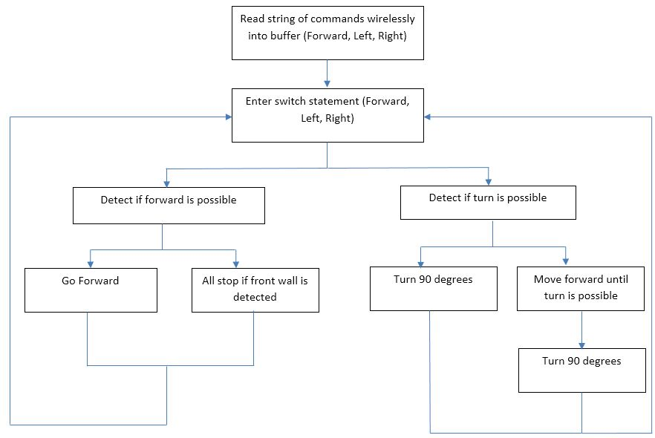
Embedded System Program Flow

Slide 40
Administrative Content

Slide 41



Sponsors
We’d like to thank Boeing and Leidos for funding our project and the UCF EECS department providing us with hardware.

Slide 42
Division of Labor
 | Jerod Rout |  | Nate Jackson |  | Hamza Nawaz |  | William Isidort
 | P | S | P | S | P | S | P | S
PCB | X |  |  | x |  | x |  | x
Software |  | x | X
Embedded |  | x |  | x | X
Communica. |  |  |  |  | X |  |  | x
UAV/Maze |  | x |  | x |  |  | X

Slide 43
Budget
Part | Purchaser | Quantity | Cost | Total Cost (Include tax+shipping when ordered)
SD1 Documentation | Hamza | 1 | $ 47.98 | $ 47.98
XBee Module | Hamza | 2 | $ 24.95 | $ 58.52
Xbee Explorer Dongle | Hamza | 1 | $ 24.95 | $ 24.95
Turnigy 9XR Pro Transmitter | Nate | 1 | $ 80.97 | $ 80.97
FrSky DJT radio module | Nate | 1 | $ 41.35 | $ 41.35
FrSky D4R-II Receiver | Nate | 1 | $ 27.88 | $ 27.88
Turnigy 2200mAh LiPo | Nate | 1 | $ 18.96 | $ 18.96
HC-SR04 Ultrasonic sensor | Nate | 6 | $ 1.10 | $ 10.10
RedBot Wheel Encoder | Nate | 1 | $ 4.95 | $ 4.95
Arduino | Hamza | 1 | $24.95 | $ 24.95
Video Converter | Hamza | 1 | $ 33.99 | $ 33.99
Camera + Transmitter | Hamza | 1 | $ 39.99 | $ 39.99
Video Receiver | Hamza | 1 | $ 36.99 | $ 36.99
Maze Materials | Will | 1 | $95 | $ 95.00
Quadcopter Repair | Will | 1 | $150 | $ 150.00

Slide 44
Progress

Slide 45
Questions?

